Slide 1
UNIT V: Z-TRANSFORMS AND DIFFERENCE EQUATIONS

Slide 2
TOPICS:
Z-Transforms –Elementary properties.
Inverse Z-Transform (using partial fractions and residues)
Convolution theorem.
4 .Formation of difference equations
5.Solutions of difference equations using
Z-Transform

Slide 3
Introduction
The Z-Transform plays an important role in the communication engineering.
In communication engineering there are two basic types of signals are encountered.
They are continuous time signal and discrete time signals.
The continuous time signals are defined by the independent variable time and are denoted by a function f(t)..

Slide 4
On the other hand, discrete time signals are defined only at discrete set of values of the independent variable and are denoted by a sequence {x(n)}.
For the continuous time signal, Laplace transform and Fourier transform play important role.
Z- Transform plays an important role in discrete time signal analysis.

Slide 5
Definition 1
Let {x(n)} be a sequence defined for n = 0, ±1, ±2, ±3, ⋅⋅⋅. Then the two sided Z-transform of the sequence x(n) is defined as
where z is a complex variable in general.
Definition 2
If {x(n)} is a casual sequence, i.e., x(n) = 0 for n < 0, then the Z-transform reduces to one-sided Z-transform and is defined as
Note: The infinite series will be convergent only for certain values of z depending on the sequence x(n).

Slide 6
Definition 3
The inverse Z-transform of Z{x(n)} = X(z) is defined as
Z⁻¹{x(z)} = {x(n)}
Definition 4
The unit sample sequence δ(n) is defined as the sequence with values
Definition 5
That unit step sequence u(n) has values

Slide 7
Definition 6
If f(t) is a function defined for discrete values of t where t = nT, n = 0, 1, 2, … T being the sampling period, then Z-transform of f(t) is defined as
Now we follow the notations
(i) Z[f(t) = F(z) and
(ii) Z{x(n)} = X(z)
(iii) We shall mostly deal with one sided Z-transform which will be here after referred to as Z-transform.

Slide 8
Theorem 1 The Z-transform is linear
i.e., (i) Z[af(t)+bg(t)] = aZ[f(t)] + bZ[g(t)]
(ii) Z[a{x(n)} + b{y(n)}] = aZ{x(n)} + bZ{y(n)}
Proof
(i)
(ii)

Slide 9
Theorem 2 Frequency shifting
(i)
(ii)
Proof
(i)
(ii)

Slide 10
Theorem 3
(i)
(ii)
Proof
(i)
Differentiating w.r.t ‘z’

Slide 11
(ii) differentiating w.r.t ‘z’

Slide 12
Theorem 4
(i)
(ii)
Proof (i)
Extending this result, we get

Slide 13
(ii)

Slide 14
Theorem 5
Shifting theorem
If then
Proof

Slide 15
Theorem 6
Initial value theorem
If then
Proof
Taking limit as z → ∞

Slide 16
Theorem 7
Final value theorem
If then
Proof

Slide 17
Taking limit as z → 1

Slide 18
Convolution of Sequences
The convolution of two sequences {x(n)} and {y(n)} is defined as x(n) * y(n) = w(n)
(if the sequences are non-casual)
(if the sequences are casual)
The convolution of two functions f(t) and g(t) is defined by

Slide 19
Theorem 11 Convolution theorem
(i)
(ii)
Proof (i) Let
(1)

Slide 20
By definition
(2)
From equation (1) and (2)
Note:

Slide 21
(ii) If F(z) and G(z) are one sided Z-transform of f(t) and g(t)

Slide 22
z-Transforms of some basic functions
Result 1
Proof

Slide 23
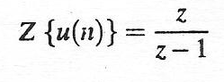
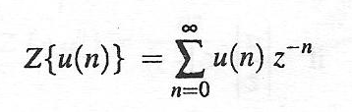
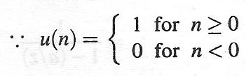
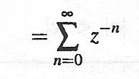
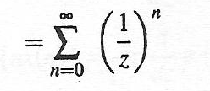
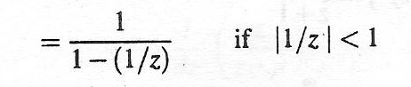
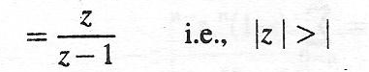
Result 2
Where u(n) is an unit step sequence
Proof :
Z[1]

Slide 24
Result 3
Proof

Slide 25
Result 4
Proof

Slide 26
Result 5
Proof

Slide 27
Result 6
Proof

Slide 28
Result 7
Proof

Slide 29
Result 8
Z{n(n – 1)}
Proof :
Z{n(n – 1)} =

Slide 30
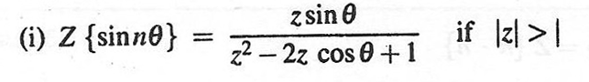
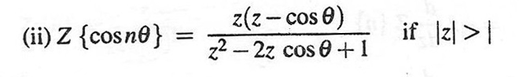
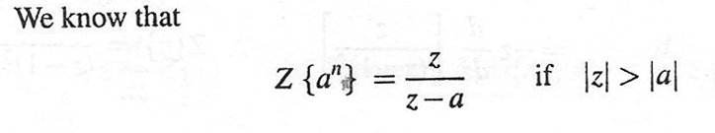
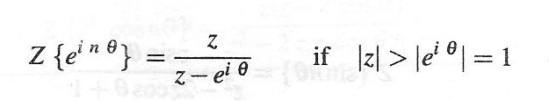
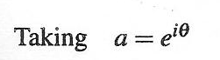
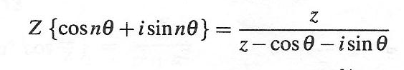
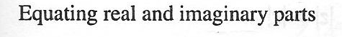
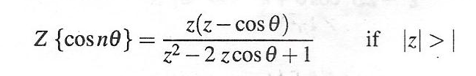
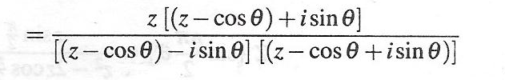
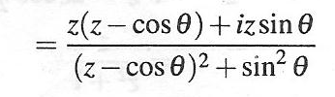
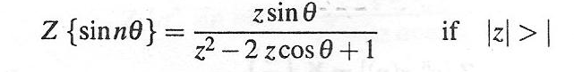
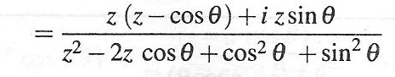
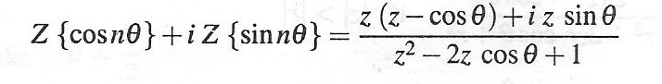
Result 9
PROOF:

Slide 31
Result 10
Find the Z – transform of the sequences
f_{n} = (n + 1)(n + 2) and g_{n} = n(n – 1)
Proof z{f(n)} = z{(n + 1)(n + 2)}
= z{n² + 3n + 2}
= z{n²} + 3z{n} + z(2)

Slide 32
Z{g(n)} = Z{n(n – 1)}
= Z{n² – n}
= Z{n²} – Z{n}

Slide 33
Result 11: Find the Z – transform
Proof

Slide 34
Result 12
Find Z(1/n)
Proof

Slide 35
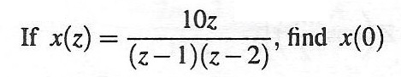
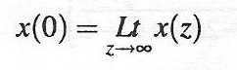
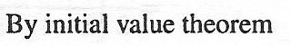
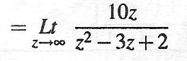
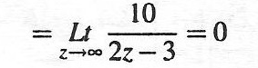
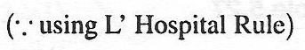
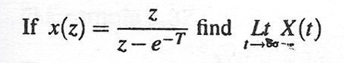
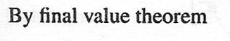
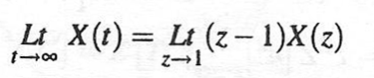
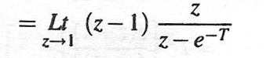
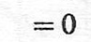
Problems based on INITIAL VALUE and FINAL VALUE THEOREM
Example -1
SOLUTION
Example -2
SOLUTION

Slide 36
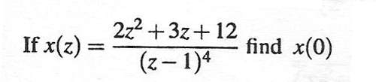
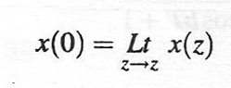
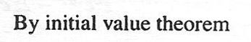
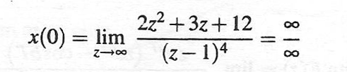
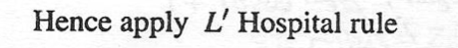
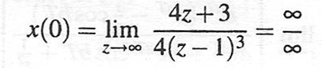
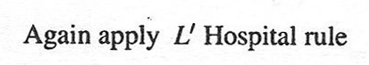
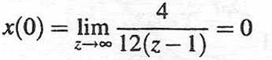
Example-3
SOLUTION

Slide 37
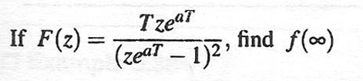
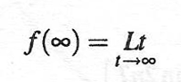
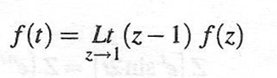
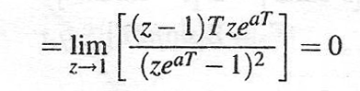
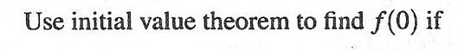
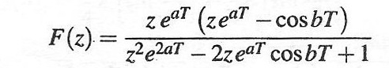
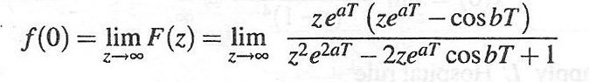
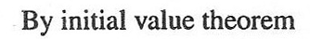
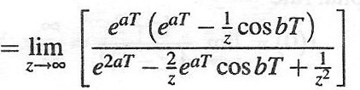
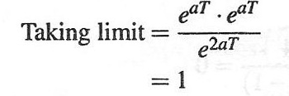
Example-4
SOLUTION
Example-5
SOLUTION

Slide 38
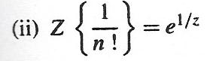








Result 13
PROOF

Slide 39











Result 14
PROOF
Result 15
PROOF

Slide 40










Result 16
PROOF
Result 17
PROOF

Slide 41
Inverse z-transforms
The inverse z-transform of X(z) defined as
Z⁻¹[X(z)] = x(n)
When X(z) = Z[x(n)]. X(z) can be expanded in a series of ascending powers of z⁻¹, by binomial exponential, logarithmic theorem, the coefficient of z^{-n} in the expansion gives Z⁻¹[X(z)].
Z⁻¹[X(z)] can be found out by any one of the following methods.

Slide 42
Methods to find inverse Z-transform:
Z⁻¹[X(z)] can be found out by any one of the following methods.
(i)Method-I Using Convolution theorem
(ii)Method-II UsingCauchys residue theorem
(iii)Method-III Using Partial Fractions method

Slide 43
Model I : Using convolution theorem
1. Using convolution theorem, find the inverse Z – transform of
Solution:

Slide 44
2. Using convolution theorem, find the inverse Z – transform of
Solution:

Slide 45
3. Using convolution theorem, find the inverse Z – transform of
Solution:

Slide 47
4. Using convolution theorem, find the inverse Z – transform of
Solution:

Slide 49
5. Using convolution theorem, find the inverse Z – transform of
Solution:

Slide 51
6. Using convolution theorem, find the inverse Z – transform of
Solution:

Slide 52
Equation (1) becomes

Slide 53
6. Using convolution theorem, find the inverse Z – transform of
Solution:

Slide 55
7. Using convolution theorem, find the inverse Z – transform of
Solution:

Slide 57
Model II : Using Cauchy’s residue theorem
By using the theory of complex variables, it can be shown that the inverse Z-transform is given by
Where c is the closed contour which contains all the isolated singularities of X(z) and containing the origin of the Z-plane in the region of convergence.

Slide 58
By Cauchy’s Residue theorem.
x(n) = Sum of the residue of X(z) z^{n-1} at the isolated
singularities.
Where
1. Residue for simple pole z = a is
2. Residue or order r at the pole Z = a is

Slide 59
1. Find using residue method.
Solution: Let = sum of the residues of
at its poles.
(i.e.) f(n) = sum of the residues of at its
poles.
z = –1 is the simple pole
and z = 1 is the pole of order 2.

Slide 61
2. Find the inverse Z – transform of by residue method.
Solution: Let = sum of the residues of
at its poles.
(i.e.) f(n) = sum of the residues of at its poles.
z = 1 is the pole of order 3.

Slide 63
Model III : Using Partial Fractions Method
When X(z) is a rational function in which the denominator is factorisable, X(z) is resolved into partial fractions and then Z-1[X(z)] is derived as the sum of the inverse Z-transforms of the partial fractions.
1. Find
Solution:

Slide 65
2. Find using partial fraction method.
Solution:

Slide 66
3. Find by the method of partial
fractions.
Solution:

Slide 68
4. Find the inverse Z-transform of
Solution:

Slide 69
(2) ⇒ A + 2C = 1 - - - - - (3)
(3)-(1) ⇒ C = 1
(1) ⇒ A = -1

Slide 71
Applications of z-transform in Solving Finite Difference Equations
Z-transform can be applied in solving difference equation.
Using the relations
…………….
where Y(z) = Z[y_{n}]

Slide 72
Applications of z-transform in Solving Finite Difference Equations
1. Solve u_{n+2} + 6u_{n+1} + 9u_{n} = 2^{n} with u₀ = u₁ = 0 using Z-transform.
Solution: Given u_{n+2} + 6u_{n+1} + 9u_{n} = 2^{n}
Taking Z – transform on both sides, we get

Slide 75
2. Solve u_{n+2} – 2u_{n+1} + u_{n} = 2^{n} with u₀ = 2, u₁ = 1 using Z - transform.
Solution: Given u_{n+2} – 2u_{n+1} + u_{n} = 2^{n}
Taking Z – transform on both sides, we get

Slide 77
3. Solve y_{n+2} + 4y_{n+1} + 3y_{n} = 3^{n} with y₀ = 0, y₁ = 1 using Z - transform.
Solution: Given y_{n+2} + 4y_{n+1} + 3y_{n} = 3^{n}
Taking Z – transform on both sides, we get

Slide 80
4. Using Z-transform solve y(n)+3y(n-1)–4y(n-2)=0 n ≥ 2 given that y(0) = 3, y(1) = -2.
Solution: Changing n into n+2 in the given equation, it becomes
y(n+2) + 3y(n+1) – 4y(n) = 0, n ≥ 0
Taking Z – transform on both sides, we get

Slide 82
5. Using Z-transform method solve y_{n+2} + y_{n} = 2 given that y₀ = y₁ = 0.
Solution: Given y_{n+2} + y_{n} = 2
Taking Z – transform on both sides, we get

Slide 84
6. Form the difference equation whose solution is
y_{n} = (A + Bn)2^{n}
Solution: Given
y_{n} = (A + Bn)2^{n} = A2^{n} + Bn2^{n} --------- (1)
y_{n+1} = [A + B(n+1)]2^{n+1} = 2[A + B(n+1)]2^{n}
= 2A2^{n} + 2B(n+1)2^{n} --------(2)
y_{n+2} = [A + B(n+2)]2^{n+2} = 4[A + B(n+2)]2^{n}
= 4A2^{n} + 4B(n+2)2^{n} -------(3)
Eliminating A and B from equations (1), (2) and (3), we have

Slide 86
7. Derive the difference equation from
y_{n} = (A + Bn)(-3)^{n}
Solution: Given
y_{n} = (A + Bn)(-3)^{n} = A(-3)^{n} + Bn(-3)^{n} --------- (1)
y_{n+1} = [A + B(n+1)](-3)^{n+1}
= -3[A + B(n+1)](-3)^{n}
= -3A(-3)^{n} - 3B(n+1)(-3)^{n} --------(2)
y_{n+2} = [A + B(n+2)](-3)^{n+2}
= 9[A + B(n+2)](-3)^{n}
= 9A(-3)^{n} + 9B(n+2)(-3)^{n} -------(3)
Eliminating A and B from equations (1), (2) and (3), we have

Slide 88



Slide 89

Table of Z- Transforms

Slide 90


Slide 91


Slide 92



Slide 93
Thank You

